Slide 1



Slide 2

Problem Statement
Agriculture is one of the significant monetary divisions in any nation.
Due to the present market situation, supply and equipment costs are catapulting which makes it harder for the farmers to cultivate as a result of overhead costs.
Right off the bat, with costs as they are today, it's hard for the farmers to attain good margins for their produce because of middlemen and the long chain of retail.
Furthermore, remaining in remote regions it gets hard for them to purchase supplies from various providers due to their outreach and lack of knowledge about present costs.
Overall, for farmers to be fruitful, a system is required to get supplies and sell their produce to be successful and accomplished.
With so much on the plate, it gets hard for them to cultivate and be successful.

Slide 3
Solution to the problem
Integrate all related systems at one place and offer an application to the farmers.
The farmers can order supplies required for farming at reasonable price on the same application.
The farmers can apply for a bank loan through the portal for large scale productions.
For small scale productions and urgent monetary help, the farmers can apply for microfinance through a hassle free process.
In times of crisis of various kinds, the farmers can apply for subsidies from the government based on the expected and actual yield and supporting documents.

Slide 4
Approach
We used an ecosystem model with enterprises and organizations
Some of the enterprises and organizations include:
Farmer Enterprise
Bank Enterprise
Micro-Finance Enterprise
Government Enterprise
Supplier Enterprise

Slide 5
Use Cases
System Manager
View/Add/Delete Network
View/Add/Delete Enterprise
View/Add/Delete Enterprise Admin
Farmer Enterprise Admin
View/Add/Delete Farmer Organization
View/Add/Delete Farmer
Bank Enterprise Admin
View/Add/Delete Bank Manager Organization/Bank background check Organization
View/Add/Delete Bank Manager/Bank background check officer
Micro-Finance Enterprise Admin
View/Add/Delete Micro-Finance Manager Organization/Micro-Finance background check Organization
View/Add/Delete Micro-Finance Manager/Micro-Finance background check officer
Government Enterprise Admin
View/Add/Delete Subsidy Manager Organization/Subsidy background check Organization
View/Add/Delete Subsidy Manager/Subsidy background check officer
Supplier Admin
View/Add/Delete Seed Supplier Organization/Fertilizer Supplier Organization/Equipment Supplier Organization
View/Add/Delete Seed Supplier Employee/Fertilizer Supplier Employee/Equipment Supplier Employee

Slide 6
Use Cases
Farmer
View Loan/Micro-loan/Orders
Apply Loan/Micro-loan/Order Supplies
Bank Manager
View Loan Application
Refer application for background check
Approve/Reject loan application
Background check officer
View Loan Application
Approve/Reject loan application
Micro Finance Manager
View Loan Application
Refer application for background check
Approve/Reject loan application
Micro Finance Background check officer
View Loan Application
Approve/Reject loan application

Slide 7
Use Cases
Subsidy Manager
View Subsidy Application
Refer application for background check
Approve/Reject loan application
Subsidy
Background check officer
View Subsidy Application
Approve/Reject loan application
Seed Supply employee
View Order
Ship/Reject order
Fertilizer Supply employee
View Order
Ship/Reject order
Equipment Supply employee
View Order
Ship/Reject order

Slide 8
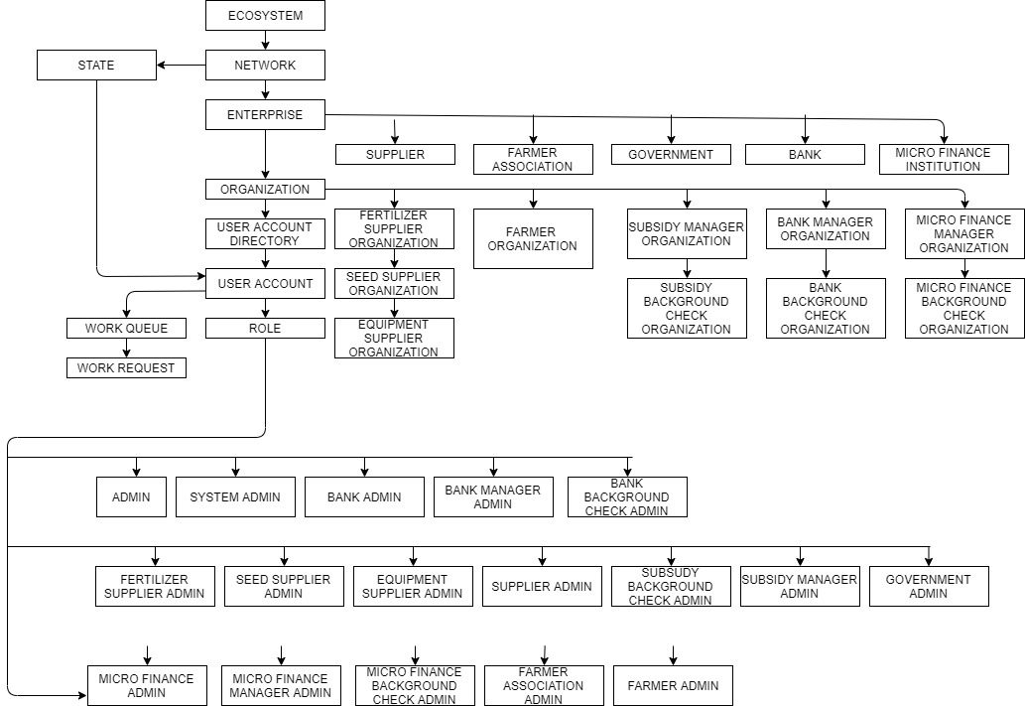
Object Diagram

Slide 9
Work Flow
Farmer -> Bank Manager -> Bank Background check Officer -> Farmer
Farmer -> Micro Finance Manager -> Micro Finance Background check Officer -> Farmer
Farmer -> Subsidy Manager -> Subsidy Background check Officer -> Farmer
Farmer -> Seed Supplier -> Farmer
Farmer -> Fertilizer Supplier -> Farmer
Farmer -> Equipment Supplier -> Farmer

Slide 10
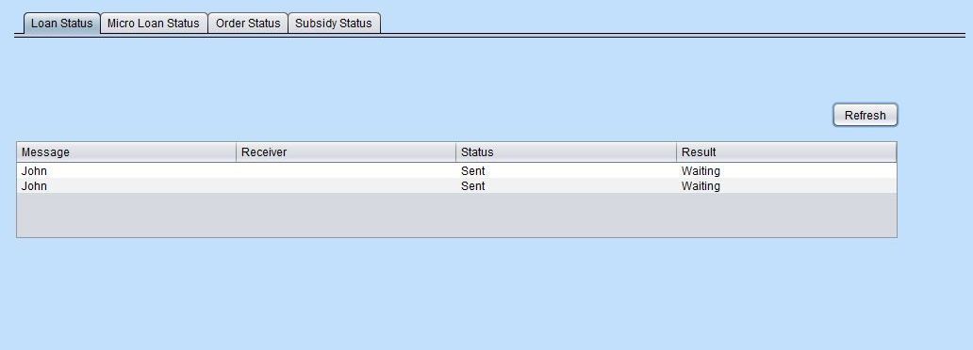
Screenshots

Slide 11
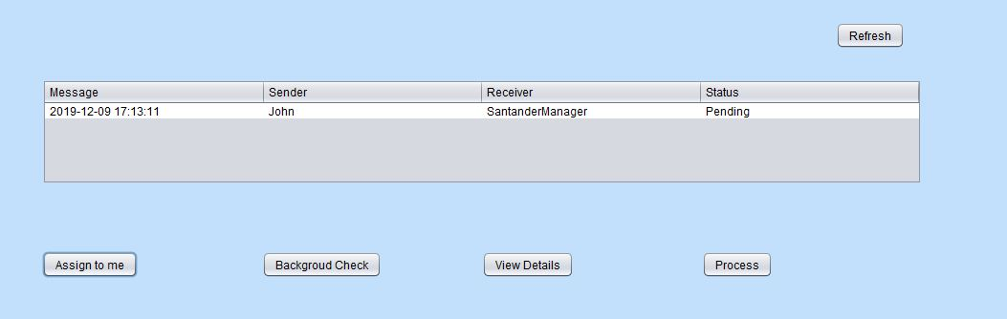

Slide 12
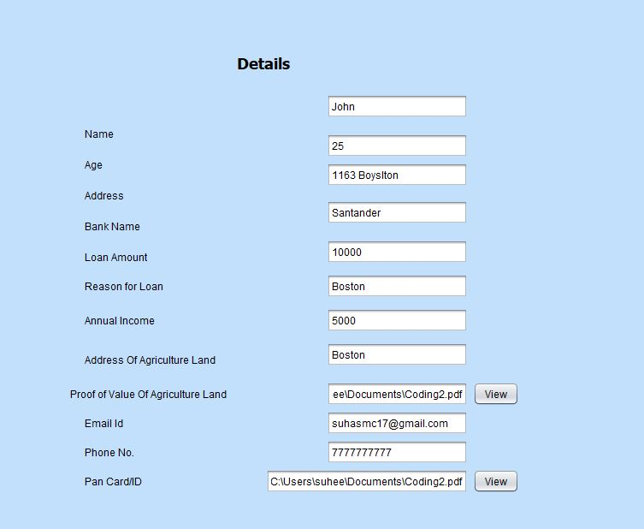

Slide 13
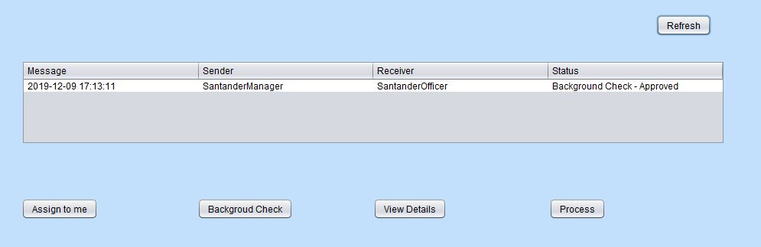

Slide 14
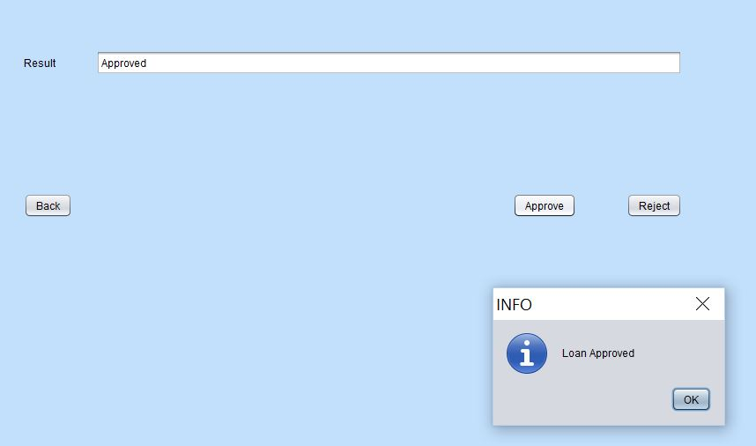

Slide 15
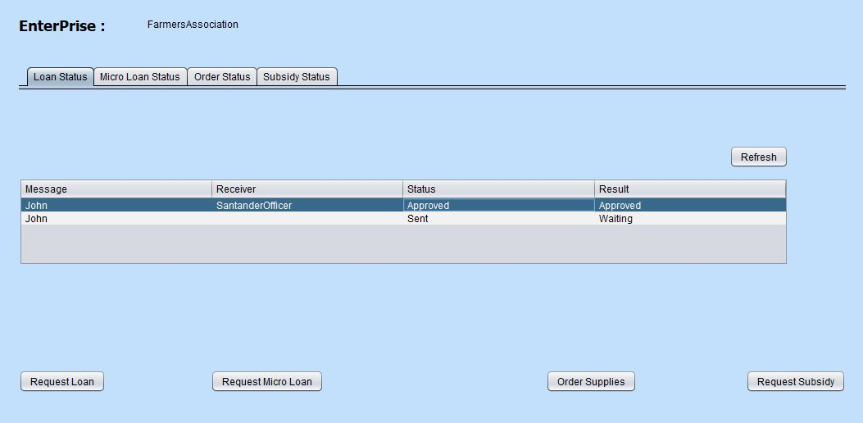

Slide 16


